Slide 1
Developing an AI-Powered Personalized Email Generator Using Python

Slide 2


Introduction to AI Email Generation
is transforming how we communicate. This presentation explores the development of an
using . We will cover the essential components, techniques, and tools required to create an effective solution that enhances email communication.

Slide 3
To develop an effective email generator, we need to understandand.
These technologiesenable machines to comprehend and generate human-like text, making them crucial for crafting personalized emails that resonate with recipients.

Slide 4




Key Python Libraries
Utilizing the right
essential for building an AI email generator. Libraries such as
is
, ,
and provide powerful tools for text processing and machine learning, enabling the creation of sophisticated email content tailored to individual needs.

Slide 5
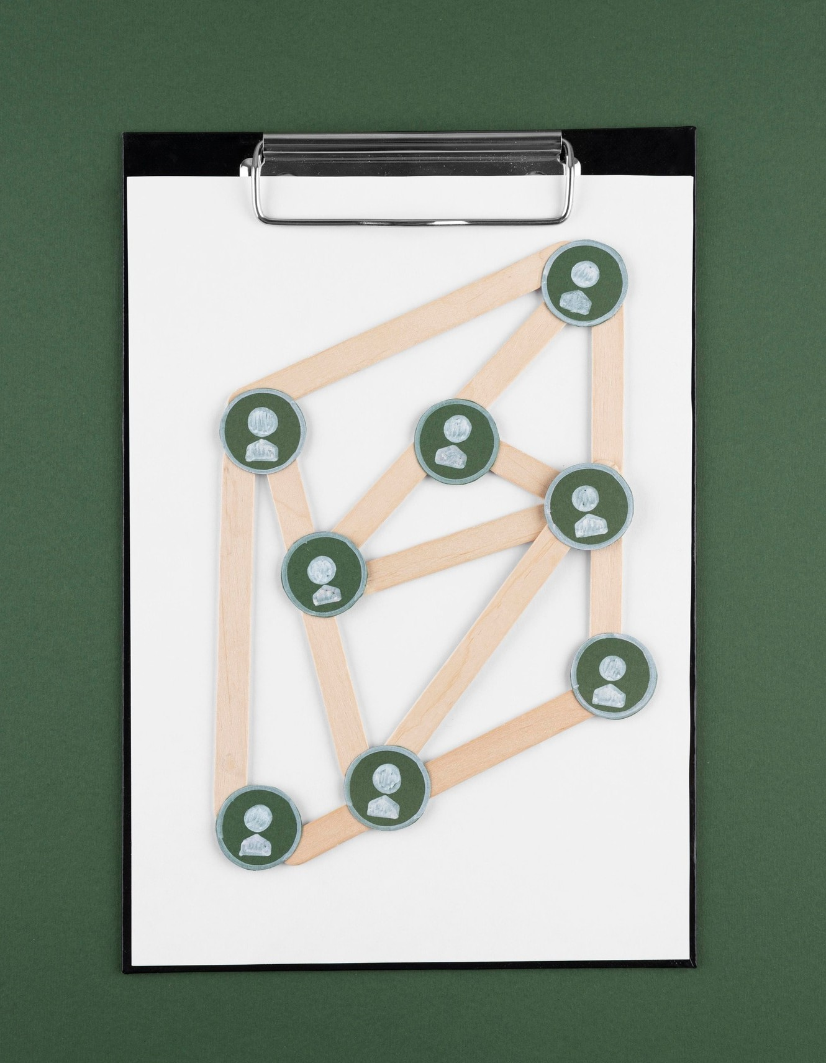
Building the Generator
The process of building an AI-powered email generator involves several steps: data collection, training the model, and integrating the generator into a user- friendly interface. Each step is crucial for ensuring that the emails generated are not only relevant but also engaging for the audience.

Slide 6



Conclusion and Future Work
In conclusion, developing an
using can signiﬁcantly enhance
communication efﬁciency. Future work may involve improving the model's accuracy and exploring advanced personalization techniques to further engage users and increase response rates.

Slide 7
Thanks!
Team learners
R.LathaMonika
T.PardhuGoud
Y.Deekshitha
K.JaiReddy

